Slide 1

Road Map

Slide 2
Our Vision
Effective, accountable and resilient National Societies
Mutually supportive and collaborative in the region
Provide best-in-class services to vulnerable communities
IFRC secretariat that provides consistent, reliable and relevant service to all National Societies
leveraging our collective capacity for leadership and accountability
augment and expand scope of support
accelerate capacity building of its members,
enhance services for vulnerable communities

Slide 3
Our Commitment
Getting closer to National Societies - Consistent, reliable and relevant support to all 49 members in sub-Saharan Africa.
Supporting National Society development - Support transparent and robust leadership, policies and management of National Societies
Shared leadership and accountability - Groups to share input and the burden of leadership on thematic issues and geographies
Thematic funding - A shift from short-term, project-based funding to multi-year, thematic funding
A more resilient world, protecting dignity and ensuring fewer lives are disrupted or ended from disaster, conflict and disease.
Measurable results, including demonstrating a change in capacity within at least 35 National Societies by 2020.
Notes:
1. Getting closer to National Societies
We will ensure that the experience of National Societies is characterized by consistent, reliable and relevant support by:
Provide seed money through grant support to all National Societies based on needs
Travel and training support to National Society staff to expand technical teams in regional office
Greater support for secondments and deployments between National Socities in the region
Support for National Societies to adapt apps and new technology.
Support to National Societies to convene diverse coalitions and lead implementation of projects.

Slide 4
Transforming how Movement Partners Coordinate
Maintain high expectations for integrity
Develop branches to localize aid
Market our programs
Support ANS leadership on key initiatives
Share the burden of leadership – SHARED LEADERSHIP
Ensure mutual respect
Identify complementarity
Agree on common measures of success and information sharing
Planning milestones

Slide 5
Trends driving how we work
Resilience – The argument is over; its essential
High expectations
among partners and beneficiaries for transparency, accountability, Movement coordination and performance.
Zero tolerance for any lapse in integrity
A paradigm shift in humanitarian and development finance
A policy shift towards localizing aid
Opportunities from technology and private sector interest
Learning through experience

Slide 6



Trends – Use of EAs and DREF by Sub-Saharan National Societies
Over CHF 1 billion in aid requests over the last 15 years
Over CHF 15 million flood related requests total 54 within the last three years.
Frequent requests from Kenya, Tanzania & Zimbabwe
Nearly CHF 500 million used to off-set famine and food insecurity

Slide 7




Trends – Use of EAs and DREF by Sub-Saharan National Societies
Requests for support for migration are mainly from Chad, Sudan, Uganda and Tanzania
Since 2002, 166 requests from 27 countries used to fight cholera, totalling CHF 240 million).
Since 2002, 60% of all cyclone-related requests for support are from Madagascar
The most hazard prone countries are Ethiopia, Kenya, Mozambique, Mali, Niger, Sudan and Uganda Uganda (UNISDR)

Slide 8
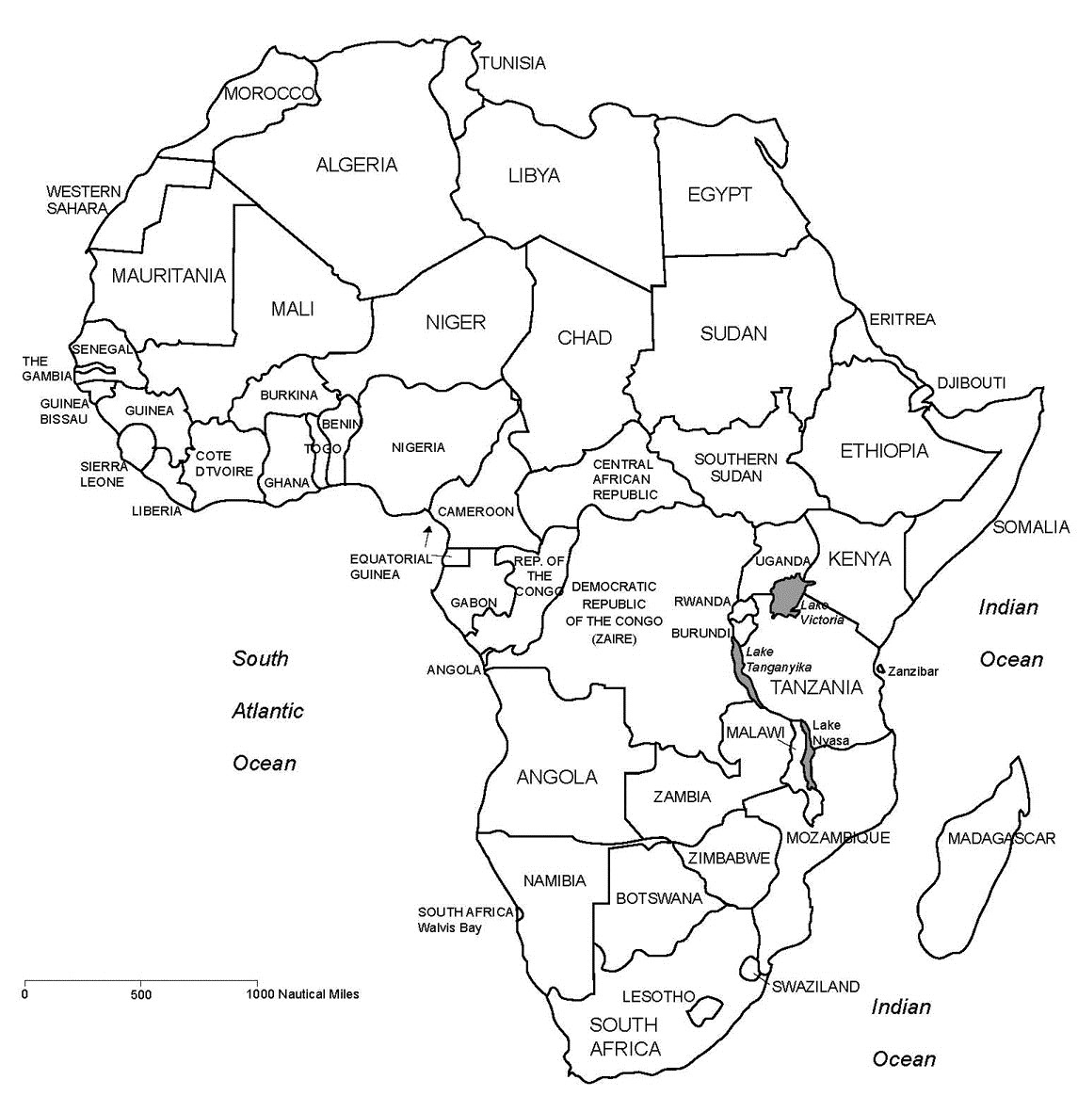
Top 10 Countries Likely To Require Assistance in 2017
(INFORM, 2016)
IFRC PRIORITY AREAS
10 AGG Countries
Central Africa Republic
Côte d’Ivoire
Gambia
Guinea Bissau
Guinea Equatorial
Mozambique
Nigeria
South Sudan
Tanzania
Zambia
RESILIENCE PROGRAMS
Lake Chad
Southern Africa
Population Movement

Slide 9
Regional Priorities – Responding to…
Chronic Food and Health needs
Population Movement
Acute Crises
National Society Development
Resilience Programs such as; WASH, Ebola recovery, the Zambezi River Basin, the Senegal River Basin, Lake Victoria Basin and the Lake Chad basin initiatives.
Instability leading to large scale displacement and refugees, such as South Sudan, Sudan, Kenya, Ethiopia, Burundi, Uganda, DRC, Gabon and Nigeria
Drought & health crises resulting in acute malnutrition and disease outbreaks; Cholera, Polio & Yellow Fever and starvation in large parts of Southern and East Africa
& the Lake Chad Basin
- Support NSs to attract investment, continuously increase capacities and professionalism, influence government decisions, build regional partnerships, and reduce the no. of hungry people
1
2
3
4
Sample Text

Slide 10
The IFRC Africa Road Map
Compliments Strategy 2020 - provides the rationale, key actions and milestones to realize the organization’s global targets
2017
2020
2018
2019
A framework to engage partners – to build a strong, resilient and effective humanitarian and development program.

Slide 11
So, how’d we do?

Slide 12
Context and value proposition
There were missed opportunities early in 2017, members made attempts to present coherent and cross-border activities to DEVCO and ECHO
Met expectations for Movement Coordination and bridging the humanitarian to development divide
One International Appeal for NE Nigeria and South Sudan
Localizing aid and mobilizing trained volunteers through a “branches as centres of resilience” lens
Analysis of the context and trends was accurate but incomplete
Food insecurity and Cholera outbreaks
The private sector has been an eager partner
Coordination with ICRC and strong participation in shared leadership groups
Questions about integrity and transparency recurring
Emergencies in DRC and Uganda bigger than expected

Slide 13
Road Map Progress Report, July 2017 (out of 3)

Slide 14
Road Map Progress Report, Dec 2017 (out of 5)

Slide 15
Road Map Progress Report, July 2017 (OUT OF 3)

Slide 16
Road Map Progress Report, Dec 2017 (OUT OF 5)

Slide 17
Top 10 Countries Likely To Require Assistance in 2017
(INFORM, 2016)
IFRC PRIORITY AREAS
10 AGG Countries
Central Africa Republic
Côte d’Ivoire
Gambia
Guinea Bissau
Guinea Equatorial
Mozambique
Nigeria
South Sudan
Tanzania
Zambia
RESILIENCE PROGRAMS
Lake Chad
Southern Africa
Population Movement

Slide 18
Summary of Operations
As of July 2017
As of Jan 2018
11 active emergency appeals
Food insecurity (6), pop movement and complex emergencies (3)
As of 7 Sept, 20 DREF operations
CHF 142 million budget; 11 million people
Develop programs that build resilience through
preparedness and organizational development,
livelihoods programs,
pre-positioning of stocks,
training of staff and volunteers
11 active emergency appeals
Food insecurity (3), pop movement and complex emergencies (2), epidemics (3)
As of 11 Jan, 16 DREF operations
CHF 143 million budget; 13.7 million people
Develop programs that build resilience through
preparedness and organizational development,
livelihoods programs,
pre-positioning of stocks,
training of staff and volunteers,
Community-based survellience

Slide 19
What’s coming?
TRENDS
A young and exploding population in Africa, to reach 1.7 billion in 2030 and 2.5 billion by 2050, will transform Africa’s labour force.
Rapid urbanization will transform risk and demands on African NS
Growing support for public-private partnerships, particularly in the health sector, esp NCDs
More opportunities for climate adaption and deepen expectations for localized aid
Unprecedented levels of need in DRC
A breaking point in Uganda
INTERNAL CHALLENGES
Low implementation rates
delays in human resource deployment
greater use of predictive data
More emphasis on communications and marketing
More branch and leadership development
A greater focus on building resilience at the onset of disaster
Increased resource allocation for shelter programs

